Slide 1
LOAN PERFORMANCE & CREDIT RISK ANALYSIS
Using Data Analytics and Machine Learning
An End-to-End Data Analytics & Business Intelligence Project
Ekene Martin Atuegbu
Data Analyst | Business Intelligence Analyst | Machine Learning Enthusiast
GitHub: github.com/Taurusking1
LinkedIn: linkedin.com/in/ekene-atuegbu-a9478b3bb
Email: kenair1@hotmail.com
Excel
MySQL
Python
Power BI
Scikit-learn
GitHub
July 2026

Slide 2







ROADMAP
Agenda
→
→
→
→
→
→
Introduction
Dataset Overview
Data Preparation
Exploratory Data Analysis
Machine Learning
BI Dashboard
Recommendations & Conclusion
Sections Covered
Sections Covered
Business Problem & Project Objectives
Dataset Description & Project Workflow
Excel Cleaning & SQL Exploratory Analysis
Python Analysis & Key Statistical Findings
Model Development, Evaluation & Comparison, Feature Importance
Power BI Dashboard Walkthrough & Portfolio Insights
Key Findings & Strategic Recommendations
Conclusion & Future Improvements
02

Slide 3
INTRODUCTION
Business Problem
The Challenge
Loan Application
Financial institutions face increasing pressure to expand lending while minimizing the risk of borrower default. Poor credit risk assessment can lead to financial losses, reduced portfolio quality, and inefficient lending decisions.
↓
Borrower Assessment
Key Challenges
↓
Difficulty identifying high-risk borrowers before loan approval
Highly imbalanced loan portfolios where default cases are rare but financially significant
Traditional assessment methods may overlook important borrower and credit characteristics
Need for data-driven insights to improve lending decisions and portfolio monitoring
Credit Risk Analysis
↓
Prediction
↓
Approve / Decline
Objective: Use historical loan data to improve credit risk assessment, identify high-risk borrowers, and support data-driven lending decisions.
03

Slide 4
INTRODUCTION
Project Objectives
Primary Objective
Specific Objectives
Perform a comprehensive analysis of loan performance and credit risk by integrating data cleaning, exploratory data analysis, business intelligence, and machine learning techniques to support data-driven lending decisions.
Clean and preprocess the raw loan dataset to improve data quality and consistency
Perform EDA to understand borrower characteristics, loan performance, and credit behaviour
Analyze key factors: income, debt-to-income ratio, loan purpose, credit history, delinquency
Evaluate portfolio health through exposure, default rates, and risk analysis
Develop interactive Power BI dashboards for executive decision-making
Build and compare multiple ML models for predicting loan performance
Identify the most influential factors via feature importance analysis
Provide actionable business recommendations for credit risk management
1. Raw Data
2. Analysis
3. Insights
4. Predictions
5. Business Decisions
Outcome: Build a reliable, data-driven framework for evaluating loan performance, predicting credit risk, and supporting strategic lending decisions.
04

Slide 5



DATASET
Dataset Overview
Attribute | Description
Dataset Type | Historical Loan Performance Dataset
Total Records | 10,000
Total Features | 59 Variables
Target Variable | Loan Status (Performing / Non-Performing)
Analysis Tools | Excel, MySQL, Python, Power BI
Borrower Information
Loan Information
Borrower Information
Credit Profile
Annual Income, Homeownership, Employment Length, Verified Income
Loan Information
Loan Amount, Interest Rate, Loan Purpose, Grade, Term
Loan Performance
Credit Profile
DTI Ratio, Credit Utilization, Inquiries, Delinquencies, Public Records
The dataset combines borrower demographics, financial characteristics, loan details, and credit history to support comprehensive credit risk analysis and predictive modeling.
Target Variable
Loan Status: Performing / Non-Performing
05

Slide 6


DATASET
Project Methodology
→
→
→
→
→
→
→
Business
Problem
Data
Collection
Excel
Cleaning
SQL
Analysis
Python
Analysis
Machine
Learning
Power BI
Dashboard
Business
Recommendations
Phase | Objective
Business Understanding | Define the lending problem and project objectives
Data Preparation | Clean, preprocess, and validate the dataset
Exploratory Analysis | Identify patterns, trends, and borrower characteristics
Predictive Modeling | Develop and evaluate machine learning models
Business Intelligence | Build interactive Power BI dashboards
Decision Support | Generate actionable business insights and recommendations
A structured analytics workflow ensured that each stage — from data preparation to predictive modeling and business reporting — contributed to reliable, actionable insights.
06

Slide 7
DATA PREPARATION
Excel Data Cleaning & Preprocessing
Objective
Raw Dataset
Prepare the raw loan dataset by improving data quality, handling missing values, and ensuring consistency before analysis and predictive modeling.
↓
Missing Value Treatment
Task | Action Taken
Missing Values | Treated missing values in employment info and delinquency history
Duplicate Records | Removed duplicate observations to maintain data integrity
Placeholder Values | Replaced missing delinquency values with 999 (No Prior Event)
Numeric Replacement | Replaced missing num_accounts_120d_past_due with 0
Data Validation | Reviewed data types and checked for inconsistencies
Final Dataset | Generated a clean dataset ready for SQL, Python, Power BI
↓
Duplicate Removal
↓
Data Validation
↓
Clean Dataset
High-quality data is the foundation of reliable analysis. Proper data cleaning improves model accuracy, strengthens business insights, and enhances decision-making.
07

Slide 8
DATA PREPARATION
SQL Exploratory Data Analysis
Business Questions Addressed
Loan Status | Loans | Exposure
Current | 9,375 | $153.4M
Fully Paid | 447 | $7.0M
In Grace Period | 67 | $1.2M
Late (31-120d) | 66 | $1.2M
Late (16-30d) | 38 | $0.6M
Charged Off | 7 | $0.09M
What is the overall composition of the loan portfolio?
Which loan purposes account for the largest share of lending?
How are loans distributed across borrower income groups?
Which loan grades carry the highest credit risk?
What is the relationship between interest rates and loan performance?
Income Group | Borrowers
Low Income | 2,245
Lower Middle | 4,689
Upper Middle | 2,610
High Income | 456
Loan Purpose | Loans | Funding
Debt Consolidation | 5,144 | $90.8M
Credit Card | 2,249 | $35.0M
Other | 914 | $11.8M
Home Improvement | 680 | $11.7M
SQL → Insight Workflow
Clean Dataset → SQL Queries → Business Analysis → Insights → Decision Support
SQL transformed raw loan records into meaningful business insights, providing the analytical foundation for predictive modeling and dashboard reporting.
08

Slide 9
DATA PREPARATION
Key SQL Insights
Portfolio Composition
SQL Analysis
Portfolio is predominantly performing loans — a small, financially significant non-performing share drives an imbalanced dataset.
↓
Borrower Income Analysis
Portfolio Insights
Most borrowers fall in middle-income categories; higher income did not necessarily mean lower credit risk.
↓
Loan Characteristics
Borrower Behaviour
Debt consolidation is the most common purpose; loans concentrate in Grades B and C (moderate risk).
↓
Credit Risk Factors
Credit Risk Indicators
Higher DTI, prior delinquencies, and higher interest rates were linked with greater credit risk.
↓
Machine Learning
Portfolio Health
The portfolio was generally healthy, though the small share of high-risk loans remains critical to monitor.
SQL analysis transformed the cleaned data into actionable business insights and identified the variables most likely to influence loan performance, laying the foundation for the predictive models.
09

Slide 10
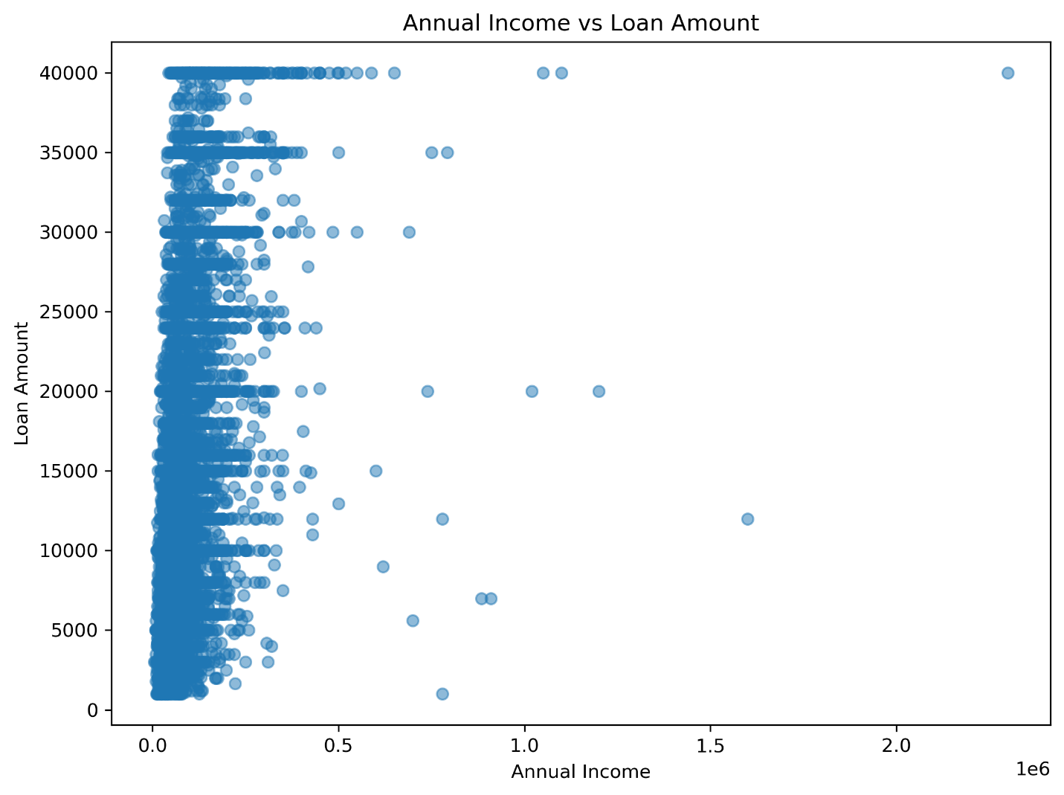
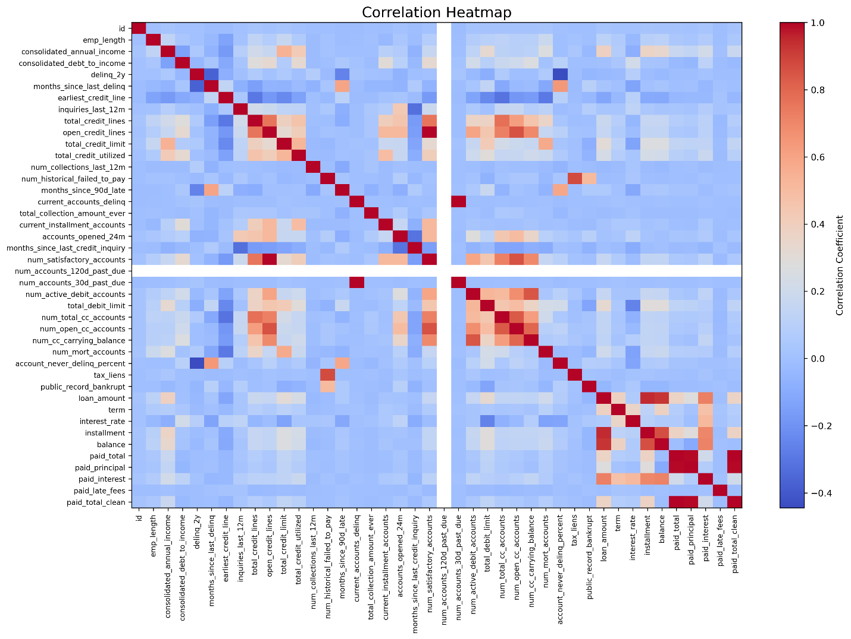
EXPLORATORY DATA ANALYSIS
Python Exploratory Data Analysis (EDA)
Objective
Perform statistical analysis and data visualization to understand borrower characteristics, loan performance, and relationships between key financial variables.
Distribution Analysis
Loan Amount, Income, Interest Rate, DTI
Relationship Analysis
Income vs Loan Amount, Rate vs Status
Income vs Loan Amount
Correlation Heatmap
Correlation Analysis
Correlation Matrix, Feature Relationships
Annual income showed only a moderate relationship with loan amount. Interest rate and DTI exhibited stronger relationships with loan performance. The target was highly imbalanced — performing loans ≈98% of the portfolio — which drove the choice of the Balanced Logistic Regression model.
Statistical Summary
Mean, Median, Std Dev, Outlier Detection
10

Slide 11
MACHINE LEARNING
Machine Learning Overview
Objective
Model | Purpose
Linear Regression | Baseline regression analysis
Standard Logistic Regression | Initial classification model
Balanced Logistic Regression | Address class imbalance
Standard Random Forest | Tree-based classification
Balanced Random Forest | Feature importance & comparison
Develop predictive models to classify loans as Performing or Non-Performing and identify the model offering the most reliable support for credit risk assessment.
1. Clean Dataset
2. Feature Selection
3. Data Encoding
4. Train-Test Split
5. Model Training
6. Model Evaluation
Why Multiple Models?
7. Model Comparison
Multiple models were developed and compared to determine which provided the most reliable predictions for loan performance while accounting for the highly imbalanced dataset.
8. Best Model Selection
Model evaluation focused on balancing overall predictive performance with the ability to detect non-performing loans, which are critical for effective credit risk management.
11

Slide 12
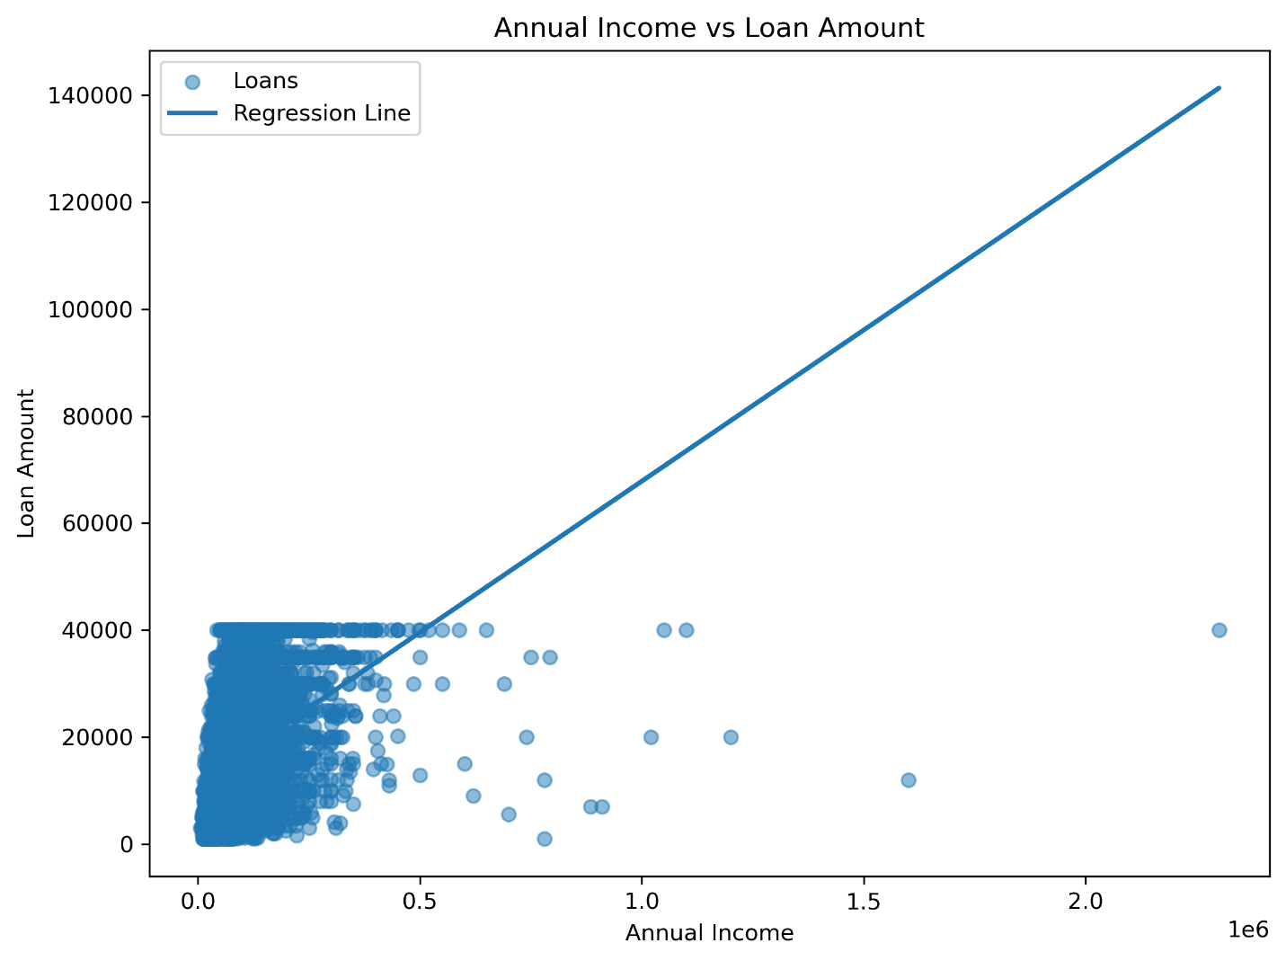
MACHINE LEARNING
Linear Regression Analysis
Why Linear Regression?
Explore relationships between financial variables
Measure the influence of borrower characteristics on loan amount
Establish a baseline model for comparison
Metric | Result
Correlation (r) | 0.381
R² Score | 0.145
P-value | < 0.001
Why It Was Not Selected
✘ Predicts continuous values, not categories
✘ Cannot classify Performing/Non-Performing
✔ Useful baseline for variable relationships
Linear Regression provided valuable baseline insights into borrower behaviour but was not suitable for predicting loan performance because credit risk is fundamentally a classification problem.
Scatter plot: moderate positive relationship between annual income and loan amount
12

Slide 13
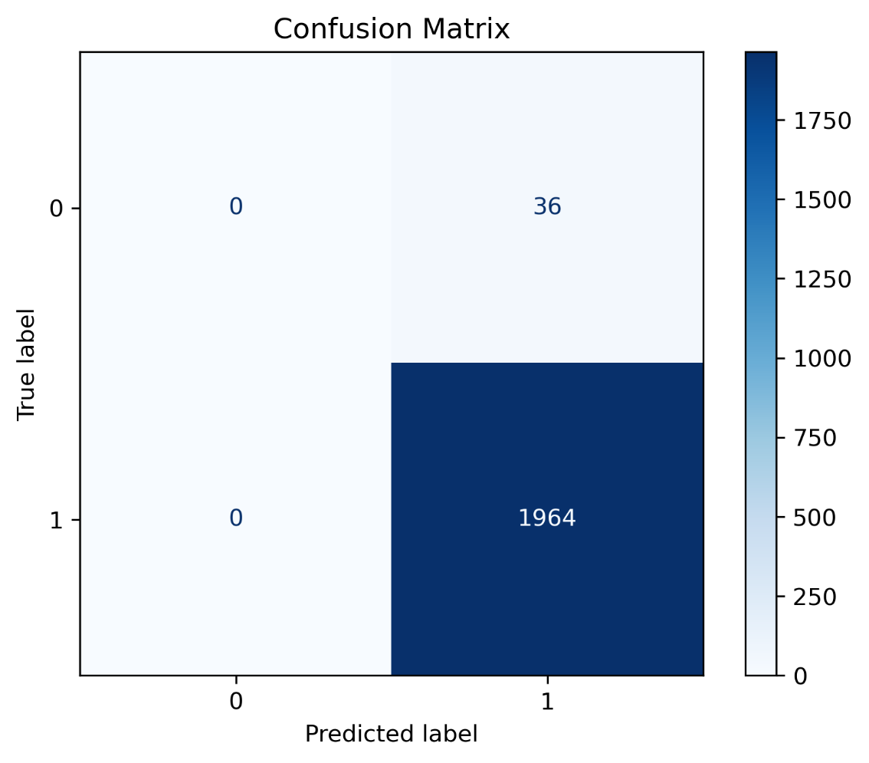
MACHINE LEARNING
Standard Logistic Regression
Objective
Develop an initial classification model to predict whether a loan would be Performing or Non-Performing.
Metric | Result
Accuracy | 98.2%
Precision | 98.2%
Recall | 100%
F1 Score | 99.1%
ROC-AUC | 0.752
36 Default Loans → Detected: 0 → Missed: 36
High accuracy alone does not guarantee a good model. In highly imbalanced datasets, confusion matrices and class-specific performance provide a more reliable assessment than accuracy.
Standard Logistic Regression — Confusion Matrix
13

Slide 14
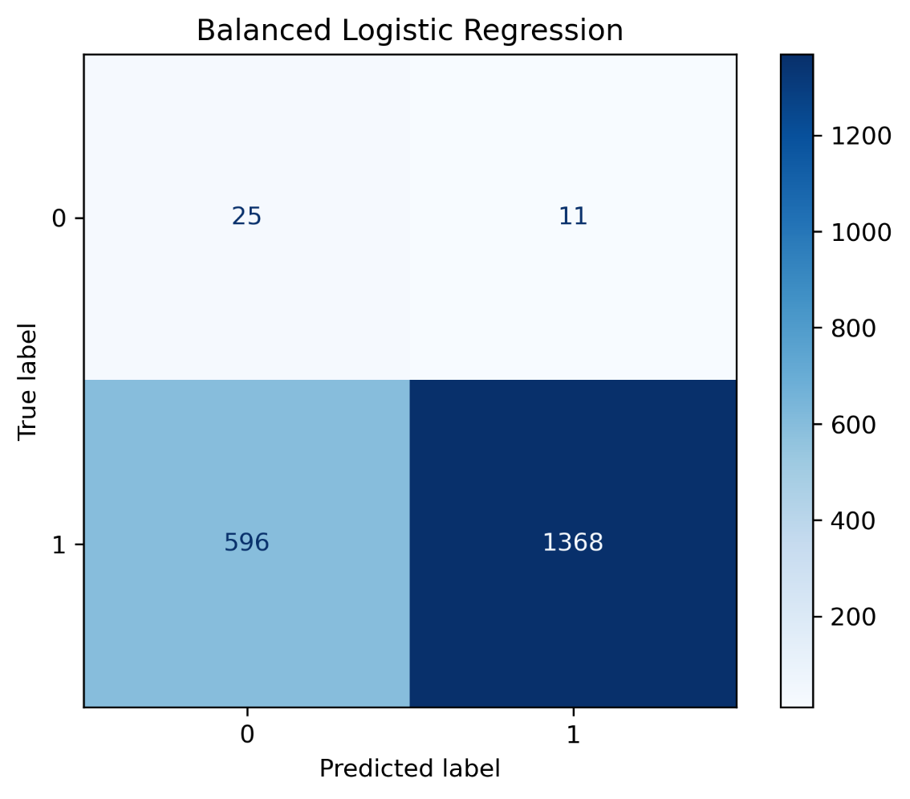
MACHINE LEARNING
Balanced Logistic Regression (Final Model)
Why a Balanced Model?
The dataset was ≈98.2% Performing vs 1.8% Non-Performing. This severe imbalance biased the standard model toward the majority class. Class weighting was used to improve detection of Non-Performing loans.
Metric | Result
Accuracy | 69.7%
Precision | 99.2%
Recall | 69.7%
F1 Score | 81.8%
ROC-AUC | 0.762
✔ 25 / 36 Non-Performing Loans Detected (≈69%)
Balanced Logistic Regression — Confusion Matrix
Balanced Logistic Regression was selected because it prioritized identifying high-risk borrowers, making it the most practical model for real-world credit risk assessment despite lower overall accuracy.
14

Slide 15
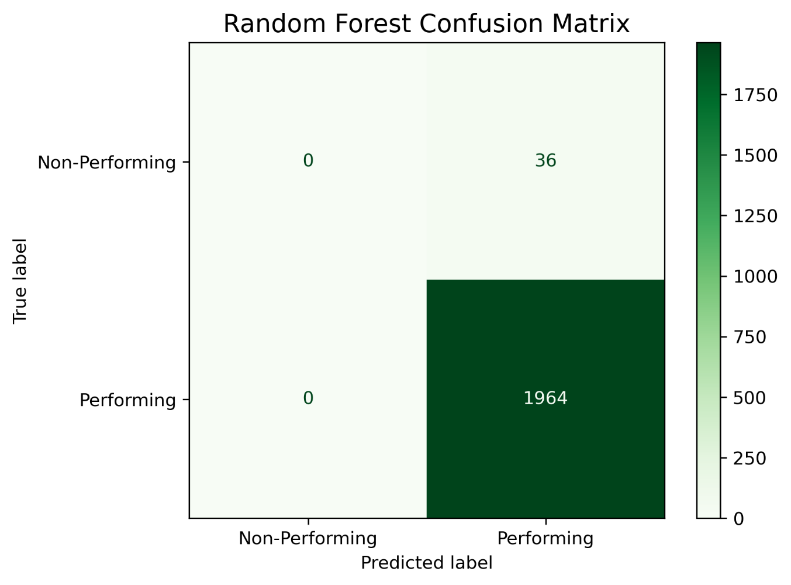
MACHINE LEARNING
Random Forest Model Evaluation
Model | Accuracy | ROC-AUC | NP Detected
Standard Random Forest | 98.2% | 0.681 | 0 / 36
Balanced Random Forest | 98.2% | 0.689 | 0 / 36
🟢 Strengths
🔴 Limitations
High Accuracy
Robust Feature Importance
Handles Complex Relationships
Detected 0 Non-Performing Loans
Biased toward Majority Class
Lower ROC-AUC than Balanced LR
Standard Random Forest — Confusion Matrix
Random Forest demonstrated strong predictive accuracy but failed to identify high-risk borrowers. Its greatest contribution was identifying the most important factors influencing loan performance.
15

Slide 16
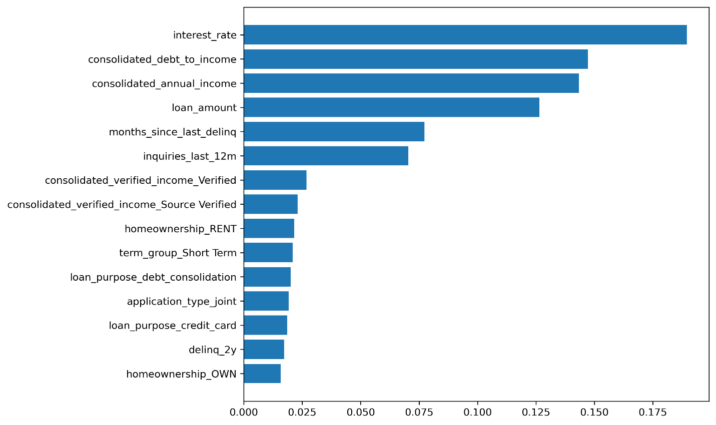
MACHINE LEARNING
Feature Importance Analysis
Interest Rate
Strongest indicator of borrower risk.
Debt-to-Income Ratio
Measures repayment capacity.
Loan Amount
Represents financial exposure.
Annual Income
Indicates repayment ability.
Top 10 Feature Importance
Months Since Last Delinquency
Key measure of stability & recovery.
Feature importance analysis revealed that credit risk is influenced by multiple financial and behavioural factors rather than any single borrower characteristic.
16

Slide 17

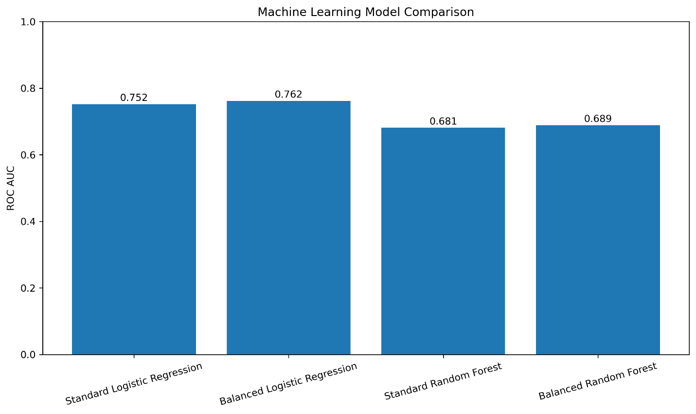
MACHINE LEARNING
Model Comparison & Final Model Selection
Model | Accuracy | ROC-AUC | NP Detected | Selected
Linear Regression | — | — | — | ✘
Standard Logistic Regression | 98.2% | 0.752 | 0 / 36 | ✘
Balanced Logistic Regression | 69.7% | 0.762 | 25 / 36 | ✔
Standard Random Forest | 98.2% | 0.681 | 0 / 36 | ✘
Balanced Random Forest | 98.2% | 0.689 | 0 / 36 | ✘
FINAL MODEL
Balanced Logistic Regression
Highest ROC-AUC
Detected 25 Defaults
Most Practical
Best Business Value
17

Slide 18
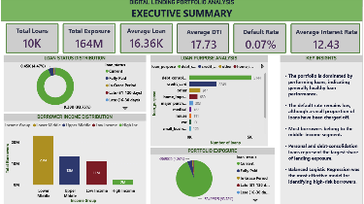
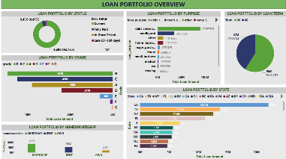
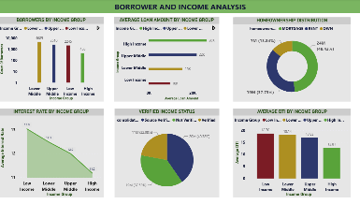
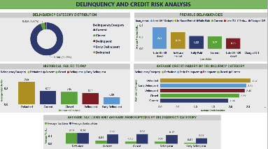
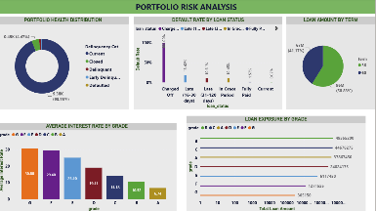
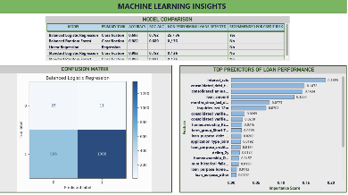
BUSINESS INTELLIGENCE
Interactive Power BI Dashboard
Objective
An interactive BI dashboard enabling stakeholders to monitor portfolio performance, identify credit risk patterns, and support data-driven lending decisions across six report pages.
Executive Summary
Portfolio Overview
Borrower Analysis
Dashboard Features
Interactive filters and slicers
Dynamic KPI cards
Drill-down analysis
Cross-filtering between visuals
Executive-level reporting
Machine learning integration
Credit Risk
Portfolio Risk
Machine Learning
The Power BI dashboard transforms complex analytical results into intuitive, interactive visualizations that support faster and more informed lending decisions.
18

Slide 19
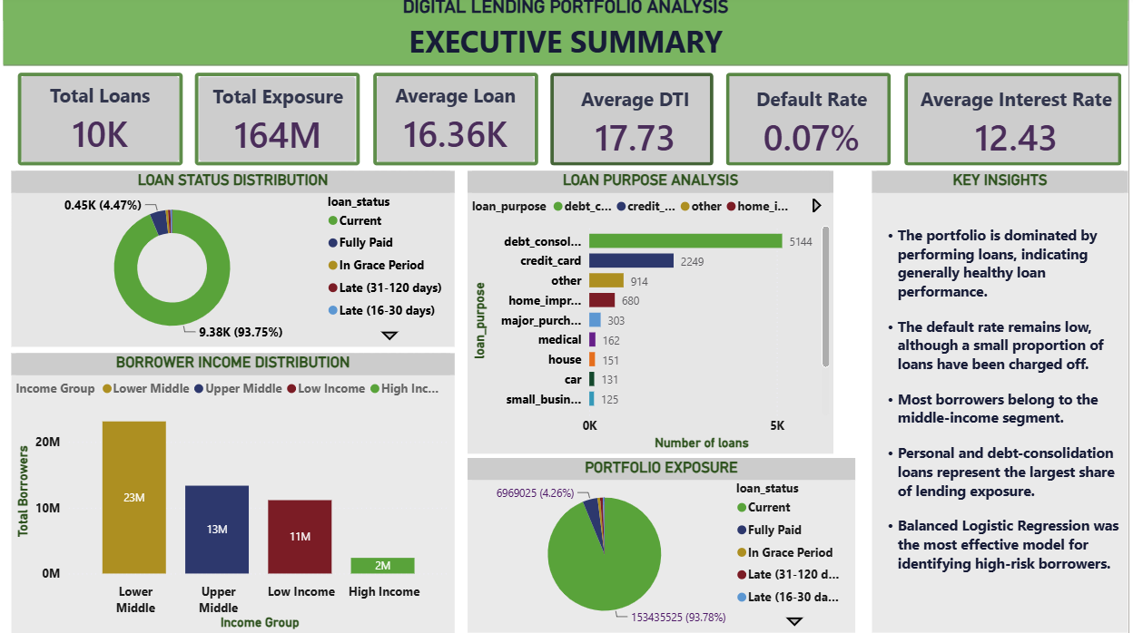
BUSINESS INTELLIGENCE
Executive Summary Dashboard
KPI | Value
Total Loans | 10,000
Total Portfolio Exposure | $164 Million
Performing Loans | 9,822 (98.22%)
Non-Performing Loans | 178 (1.78%)
Avg. Interest Rate | 12.43%
Avg. Annual Income | $89,138
Key Insights
98.22% of loans performing — strong portfolio quality
$164M in outstanding exposure requires ongoing monitoring
12.43% average rate reflects balanced, risk-based pricing
Non-performing loans remain financially significant at 1.78%
The portfolio demonstrates strong overall performance with $164 million in loan exposure and a 98.22% performing loan rate, while highlighting the need to continuously monitor non-performing loans.
19

Slide 20
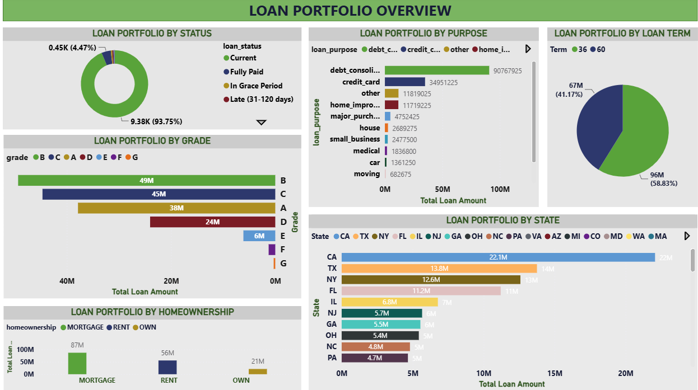
BUSINESS INTELLIGENCE
Loan Portfolio Overview
Current Loans
93.75% of Portfolio
Largest Loan Purpose
Debt Consolidation ($90.8M)
Highest Grade Exposure
Grade B ($49M)
Most Common Term
36 Months (58.83%)
Largest Homeownership
Mortgage Borrowers ($87M)
Highest Geo Exposure
California ($22.1M)
The loan portfolio is well-diversified across loan purposes, borrower profiles, credit grades, loan terms, and geographic regions, contributing to overall portfolio stability.
20

Slide 21

BUSINESS INTELLIGENCE
Borrower & Income Analysis
Income Group | Avg Loan | Avg Rate | Avg DTI
Low Income | $10K | 13.0% | 18.70
Lower Middle | $15K | 12.5% | 18.14
Upper Middle | $22K | 12.0% | 17.03
High Income | $26K | 11.2% | 12.81
Key Findings
Loan amount increases with income
Interest rates decrease as income rises
Higher-income borrowers carry lower DTI
Mortgage is dominant homeownership status
Borrower income significantly influences loan size, interest rates, and debt burden, highlighting the importance of multi-factor creditworthiness assessment.
21

Slide 22
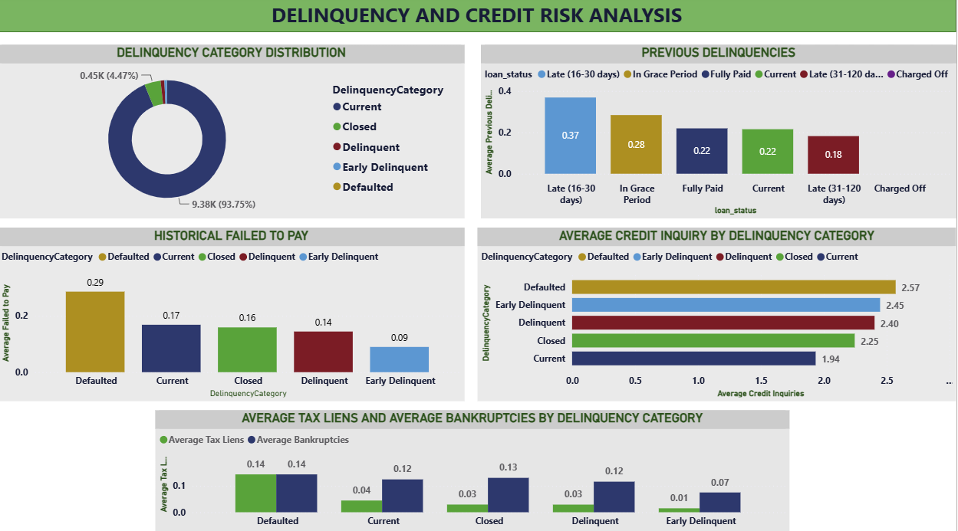
BUSINESS INTELLIGENCE
Delinquency & Credit Risk Analysis
Current Loans
93.75%
Highest Prior Delinquencies
Late (16-30 Days)
Highest Failed-to-Pay History
Defaulted Borrowers
Highest Credit Inquiries
Defaulted (2.57)
Highest Tax Liens & Bankruptcies
Defaulted Borrowers
Historical borrower behaviour — previous delinquencies, failed payments, credit inquiries, tax liens, and bankruptcies — provides strong early warning signals for default risk.
22

Slide 23

BUSINESS INTELLIGENCE
Portfolio Risk Analysis
Current Loans
93.75% of Portfolio
Highest Default Rate
Charged Off (100%)
Largest Loan Exposure
Grade B ($49.36M)
Most Common Term
36 Months (58.83%)
Highest Interest Rate
Grade G (30.80%)
The portfolio demonstrates strong overall health, with lending concentrated in lower-risk credit grades and supported by an effective risk-based pricing strategy.
23

Slide 24

BUSINESS INTELLIGENCE
Machine Learning Insights
Best Model
Balanced Logistic Regression
ROC-AUC
0.762
High-Risk Loans Detected
25 of 36
Most Important Predictor
Interest Rate
Top Predictors
Interest Rate
Debt-to-Income Ratio
Annual Income
Loan Amount
Balanced Logistic Regression proved most effective because it prioritized identifying high-risk borrowers over overall accuracy, making it more suitable for real-world lending applications.
24

Slide 25
RECOMMENDATIONS
Business Recommendations
Adopt the Balanced Logistic Regression Model
Expected Benefits
Integrate it into the credit evaluation process — it best identifies high-risk borrowers.
Lower Default Risk
Better Loan Approval Decisions
Improved Portfolio Quality
Higher Profitability
Stronger Credit Risk Management
Strengthen Borrower Risk Assessment
Use multiple characteristics: DTI, interest rate, income, delinquencies, inquiries.
Monitor Early Warning Indicators
Watch rising credit inquiries, delinquency history, high DTI, tax liens, bankruptcies.
Maintain a Balanced Lending Portfolio
Concentrate on Grades A-C; apply stricter underwriting to Grades D-G.
Continue Risk-Based Pricing
Higher-risk borrowers pay higher rates — ensures fair compensation and stability.
Combining descriptive analytics, interactive dashboards, and machine learning enables financial institutions to make more informed lending decisions and build a healthier, more resilient loan portfolio.
25

Slide 26
CONCLUSION
Conclusion & Future Work
Project Summary
This project combined data analytics, business intelligence, and machine learning to evaluate loan performance and identify the key factors influencing credit risk — transforming raw lending data into actionable insights.
Final Takeaways
Strong Portfolio Health
Data-Driven Decision Making
Improved Credit Risk Identification
Interactive Business Intelligence
Predictive Machine Learning
Actionable Business Recommendations
Objectives Achieved
Comprehensive data cleaning and preparation
Exploratory data analysis of borrower and portfolio characteristics
Interactive Power BI dashboards for portfolio monitoring
Multiple ML models developed and compared for loan performance prediction
Identified the most influential predictors of loan performance
Future Improvements
Collect more recent lending data
Apply advanced models (XGBoost, LightGBM, CatBoost)
Explore probability-based risk scoring; incorporate macroeconomic indicators
“Effective credit risk management is not about predicting every default — it is about identifying the right borrowers at the right time using data-driven insights.”
26

Slide 27
Thank You
Questions & Discussion
Ekene Martin Atuegbu
📧 kenair1@hotmail.com 💼 linkedin.com/in/ekene-atuegbu-a9478b3bb 💻 github.com/Taurusking1
Data Analytics | Business Intelligence | Machine Learning

